Slide 1
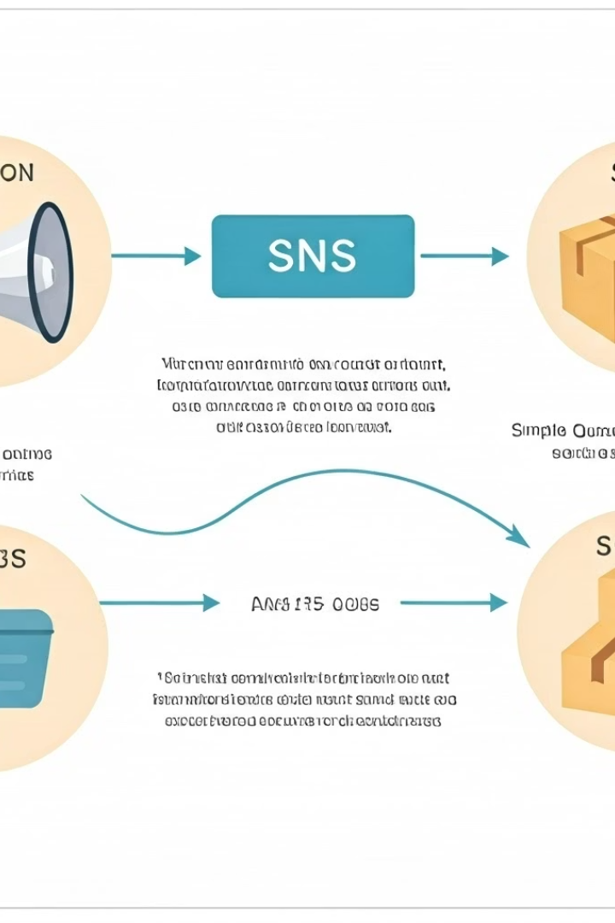

SNS vs SQS: A Simple Explanation
What are SNS and SQS?
Both SNS (Simple Notification Service) and SQS (Simple Queue Service) are services from Amazon Web Services (AWS).
They are used to help applications talk to each other, especially when sending messages or data from one system to another.
But they work in different ways.
by Ram N Java

Slide 2
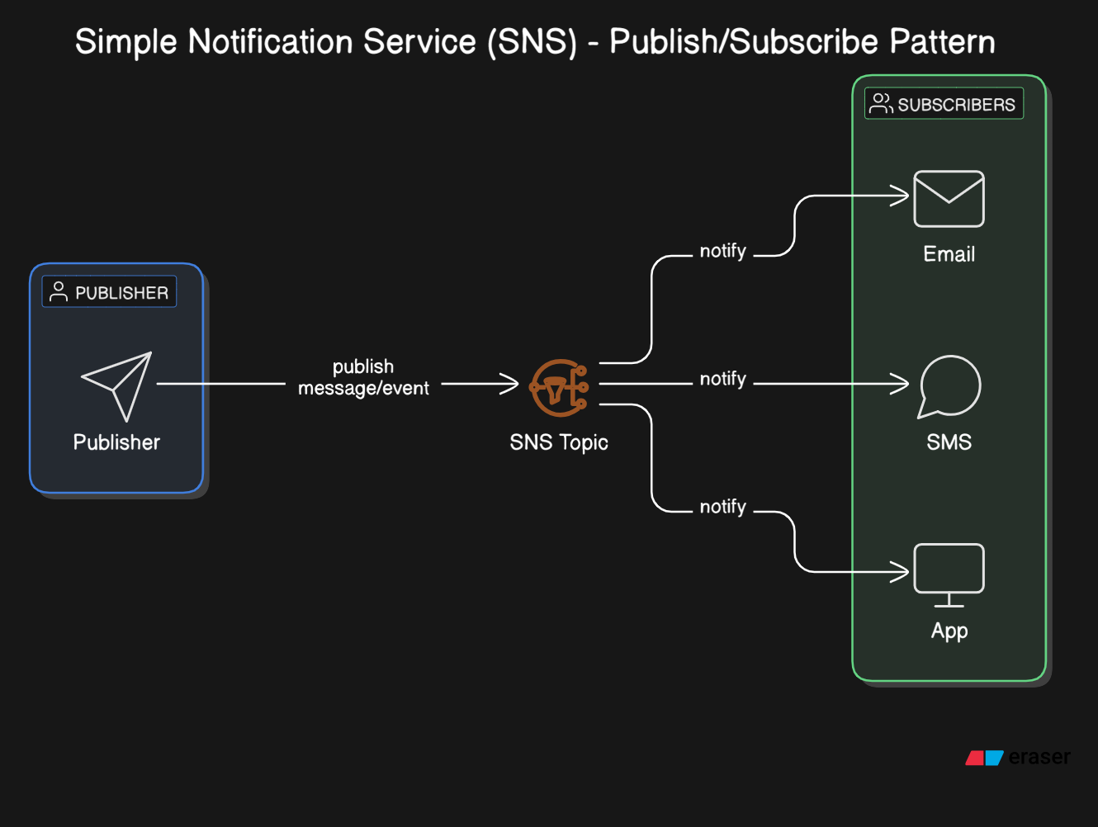


Slide 3
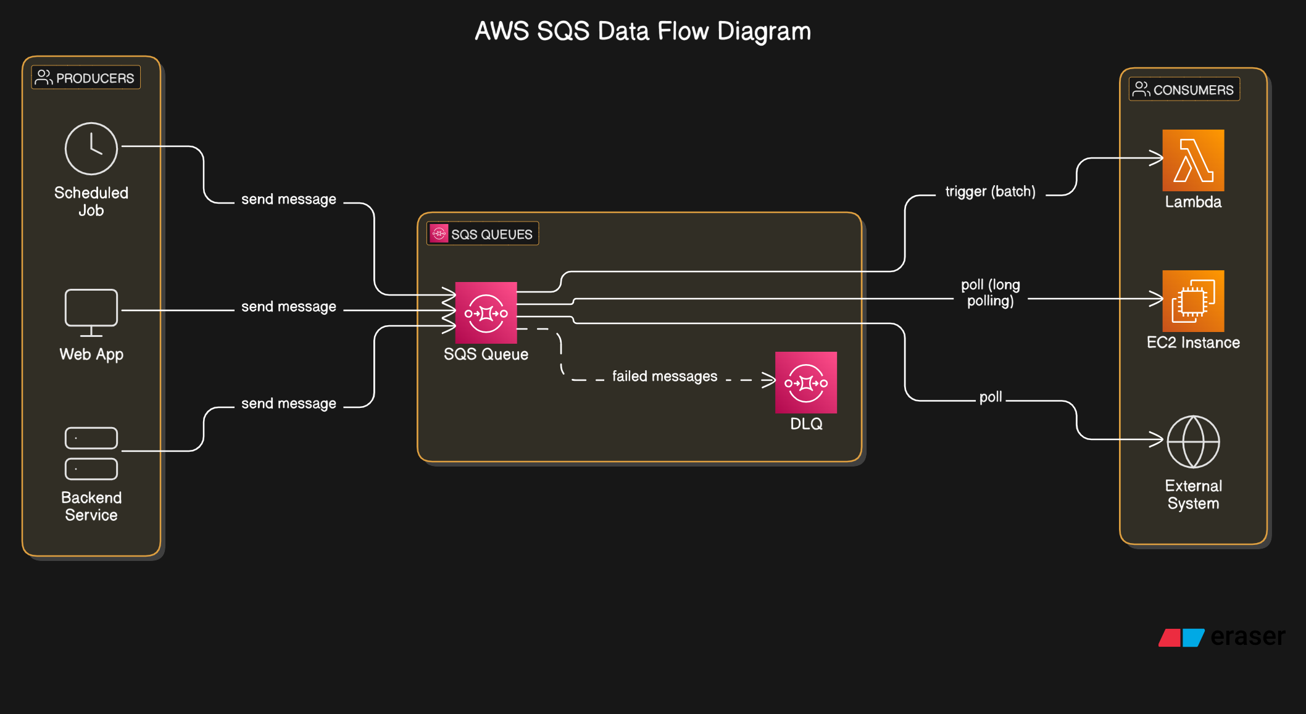

Slide 4




What is SNS?
Publish-Subscribe System
Multiple Receivers
Many other systems can receive (subscribe) to that message at the same time.
One system sends (publishes) a message.
One-to-Many
Like social media - one message goes to many receivers.
SNS stands for Simple Notification Service.
Example: When you post a photo on social media, all your followers get a notification. That's like SNS – one message goes to many receivers.

Slide 5

What is SQS?
Message Queue System
Messages are organized in a structured system
Waiting Line
Messages are put in a queue (a waiting line)
One at a Time Processing
Other systems take messages from the queue one at a time
SQS stands for Simple Queue Service.
Example: Think of a customer service center. Calls come in and are placed in a queue. Each support agent takes one call at a time. That's like SQS – messages are handled one by one.

Slide 6
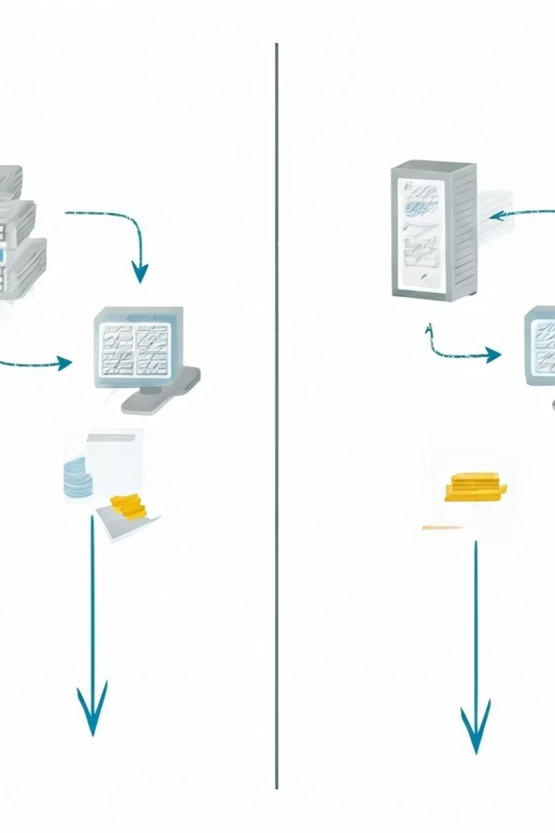
Key Differences Between SNS and SQS
Feature
SNS
SQS
Full Form
Simple Notification Service
Simple Queue Service
Message Model
Publish/Subscribe
Queue (First In, First Out)
Receivers
Many can receive the same message
One message goes to one receiver
Use Case
Send updates or alerts to many
Handle tasks or work items in order
Real-time?
Yes, sends messages immediately
No, messages are processed slowly
Delivery Method
Push (SNS pushes messages to others)
Pull (SQS waits for someone to pull it)

Slide 7

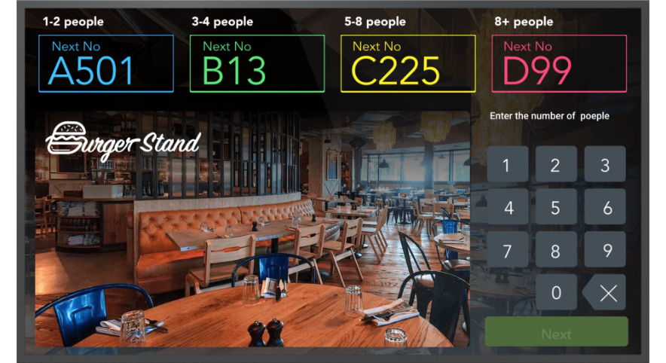
When to Use SNS vs SQS
When to Use SNS?
When to Use SQS?
Use SQS when you want to process tasks one by one, in the right order. For example:
Use SNS when you want to send a message
to many systems or users at once. For example:
Handling customer orders
Sending alerts to multiple apps
Processing image uploads
Notifying different services at the same time
Running background jobs
Can You Use Both Together?
Yes! You can connect SNS to SQS. SNS can send messages to an SQS queue, and then other apps can process them one by one.

Slide 8
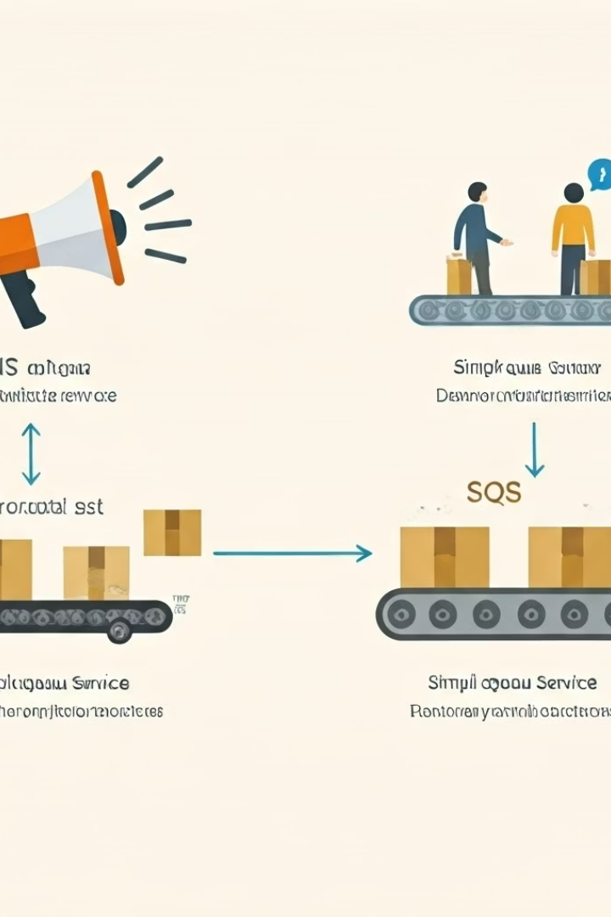






Summary
AWS Messaging Services
Tools for application communication
SNS
Send one message to many receivers
SQS
Send many messages to be handled one by one
Both are great tools, and your choice depends on how your app needs to handle messages.

